Slide 1

Bangkok Vs. Global Temperature
By Isa Phuyuthanon

Slide 2
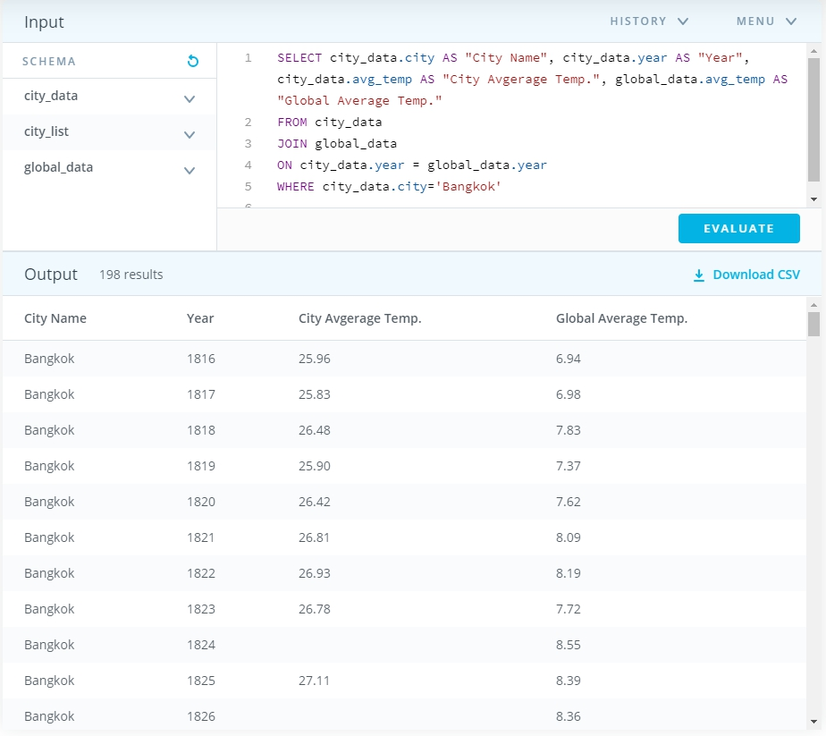
SQL query
For this project I have chosen to query a data from two data set which are city_data and global_data where I selected column as from the picture and perform an inner join so that the year on both data set are a match.

Slide 3
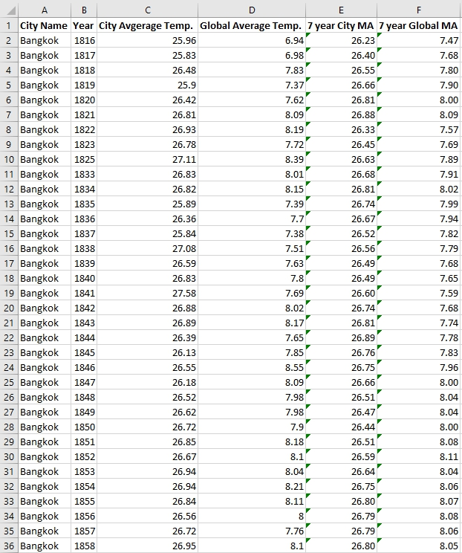
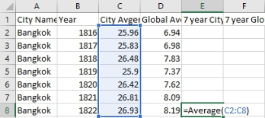
Data manipulating
In this process I have calculated 7 years moving averages for both Bangkok and Global Temperature on Excel. To calculate for MA, I basically use the build-in Average function on excel and selected seven years average temperature and keep doing this till the end of the row. I’m applying the same method for the 7 years MA global temperature.

Slide 4
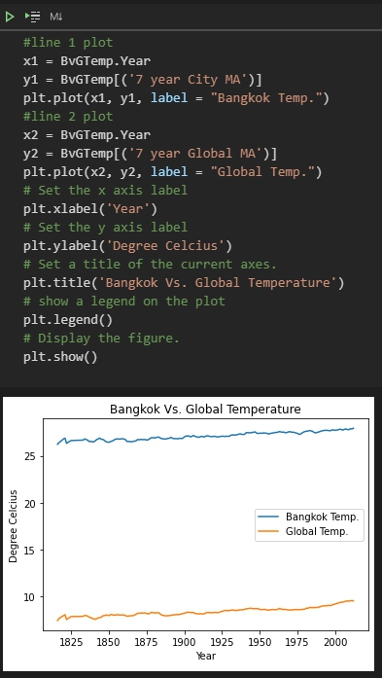
Data Visualization
In this step I have use Python: Matplotlib as my data visualize tool. I have chosen a line chart where the axes and the legend are clearly on the chart.

Slide 5
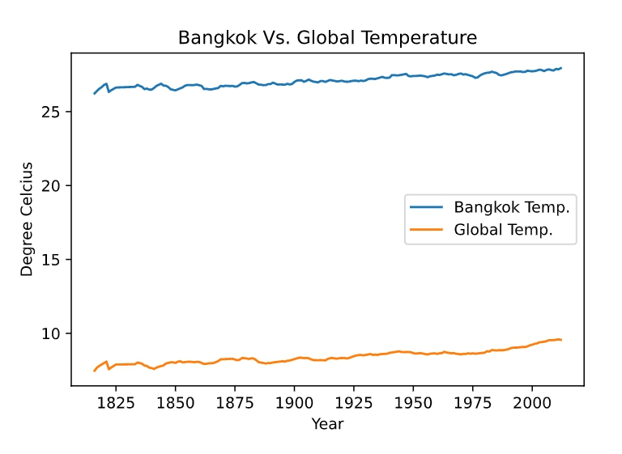
Interpreting the data
Bangkok temperature has been consistently increasing every year, the highest recorded was in 2010 and the temperature was 28.54 °C. The lowest recorded was in 1862 at 25.37 °C.
Global temperature has also been consistently increasing every year. The highest ever been recorded was in 2007 at 9.73 °C and the lowest was in 1816 at 6.94 °C.
The similarity between Bangkok’s average temperature and Global’s average temperature is that it is consistently increasing over the year.
The big difference between both temperature is that Bangkok lies in the tropical latitudes whereas when researcher calculate for the global average temperature on a grid weighted by area on the grid point: latitudes further away from the equator have smaller areas therefore global temperature is recorded generally low over year.

